Slide 1
Home Loan Default Prediction Using Deep Learning
Name: Dheeraj Rajnish Choudhary
Institute: Stevens Institute of Technology
CWID: 20030478

Slide 2
Project Objective
Develop a predictive model to assess the risk of home loan defaults using deep learning.
Address class imbalance in the dataset to improve the detection of minority class (defaults).
Implement feature engineering, hybrid sampling, and custom loss functions to enhance model performance.

Slide 3
Dataset Overview
Dataset: https://www.kaggle.com/datasets/deependraverma13/house-loan
data-analysis-deep-learning/data
Rows: 307,511
Features: 122
Target: (1 = Default, 0 = Non-Default)
Challenge: Significant class imbalance with approximately 5–10% default cases

Slide 4
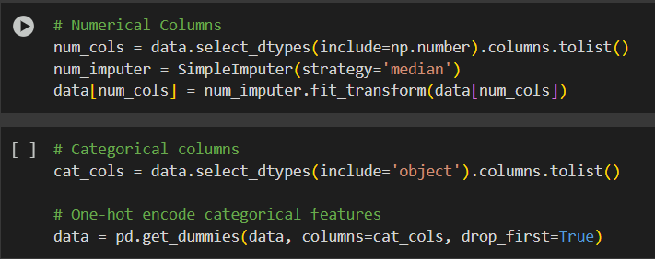
Data Cleaning and Imputation
Missing Values Handling:
Numerical features: Imputed using median values.
Categorical features: Imputed using mode values.
Data Retention: No rows were dropped to preserve the dataset's size and maintain the presence of minority class instances.

Slide 5
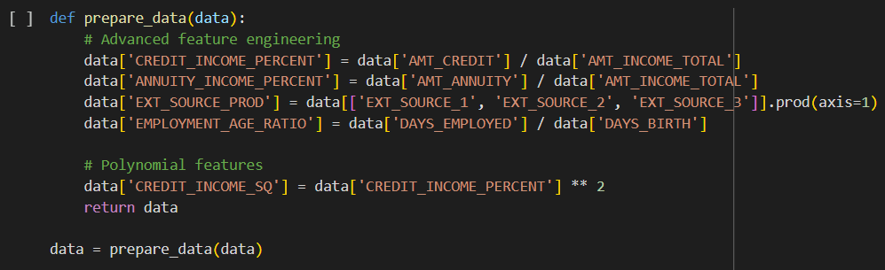
Feature Engineering
New Features Created:
CREDIT_INCOME_RATIO: Ratio of credit amount to total income, indicating debt burden.
EXT_SOURCE_MEAN: Mean of external credit scores, reflecting overall creditworthiness.
DAYS_EMPLOYED_%: Employment duration as a percentage of age, indicating job stability.
Purpose: These engineered features aim to extract predictive insights from raw data, enhancing the model's ability to detect defaults.

Slide 6
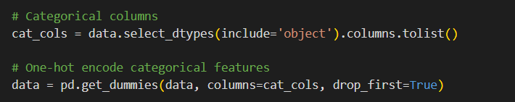
Encoding Categorical Features
Technique: One-hot encoding applied to non-binary categorical columns.
Result: Increased dimensionality of the dataset, which can lead to sparsity but allows the model to process categorical variables effectively.

Slide 7
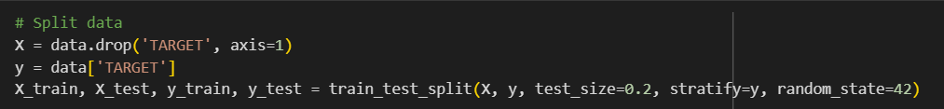
Train-Test Split
Split Ratio: 80% training and 20% testing.
Stratification: Performed on the target variable to preserve the class distribution in both training and testing sets.

Slide 8
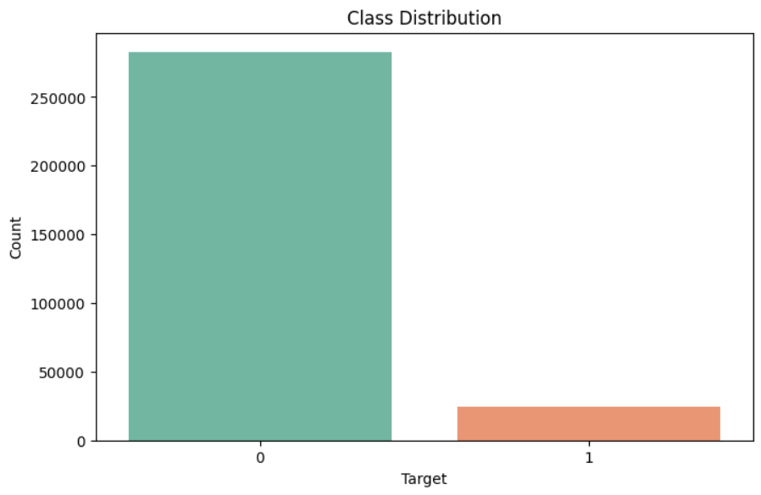
Class Imbalance Challenge
Issue: Severe imbalance with only about 5–10% default cases.
Impact: Traditional machine learning models tend to favor the majority class, leading to poor detection of defaults.

Slide 9
Hybrid Resampling
SMOTEENN (Synthetic Minority Over-sampling Technique + Edited Nearest Neighbors)
A hybrid resampling strategy that combines:
SMOTE (Over-sampling):
Generates synthetic samples of the minority class (defaults) using k-nearest neighbors.
Helps balance the dataset by increasing minority class representation.
In the code, SMOTE(k_neighbors=5) ensures more diverse synthetic samples.
ENN (Edited Nearest Neighbors, Under-sampling):
Cleans noisy and ambiguous majority class samples by removing instances that differ from the majority of their neighbors.
Sharpens the decision boundary and reduces overlapping areas.

Slide 10
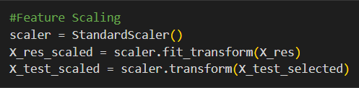
Feature Scaling
Method: Applied StandardScaler to normalize input features.
Reason: Ensures that features with larger scales do not dominate the learning process, leading to a more balanced model training.

Slide 11
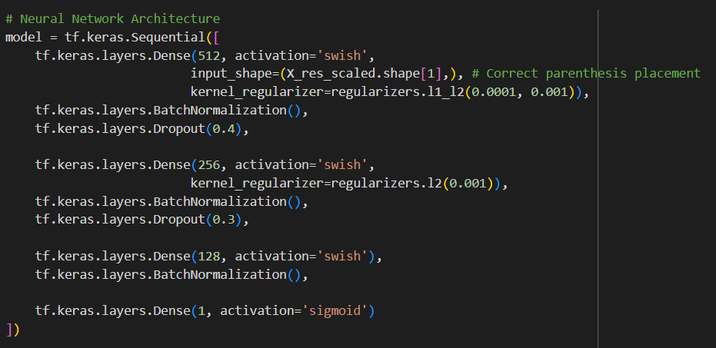
Neural Network Architecture
A 4-layer deep feedforward neural network was built using TensorFlow/Keras for binary classification.
Swish activation was used in hidden layers for better gradient flow and performance.
Regularization techniques included L1-L2 (Elastic Net), Batch Normalization, and Dropout.
The output layer used a Sigmoid activation to predict default probability.

Slide 12
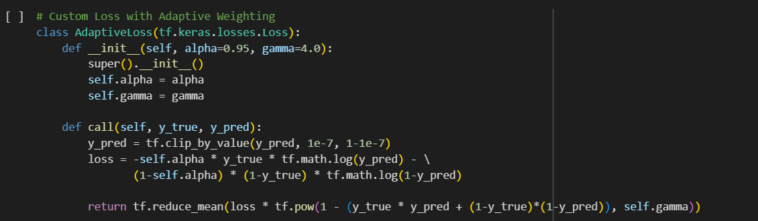
Custom Weighted Focal Loss
A custom loss class AdaptiveLoss was implemented using TensorFlow's tf.keras.losses.
Loss API.It combines focal loss with class weighting using parameters alpha = 0.95 and gamma = 4.0.
The loss increases focus on hard-to-classify defaults while down-weighting easy examples.
tf.reduce_mean aggregates the weighted losses across all predictions.

Slide 13
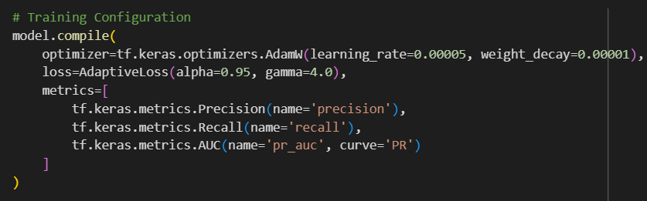
Model Compilation
The model was compiled using the AdamW optimizer with a learning rate of 0.00005 and weight decay of 0.00001.
The custom AdaptiveLoss was used as the loss function with alpha = 0.95 and gamma = 4.0.
Evaluation metrics included precision, recall, and PR AUC (area under the precision-recall curve).
These metrics help measure model effectiveness on imbalanced data, especially for identifying defaults.

Slide 14
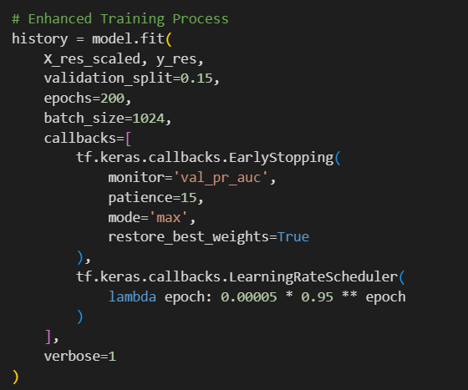
Training Strategy
Model training used 200 epochs and a large batch size of 1024 with 15% validation split.
EarlyStopping callback monitored validation PR AUC with patience = 15 to avoid overfitting.
Best weights were restored after training if no improvement was seen.
A learning rate scheduler was used to decay learning rate by 5% each epoch for stable convergence.

Slide 15
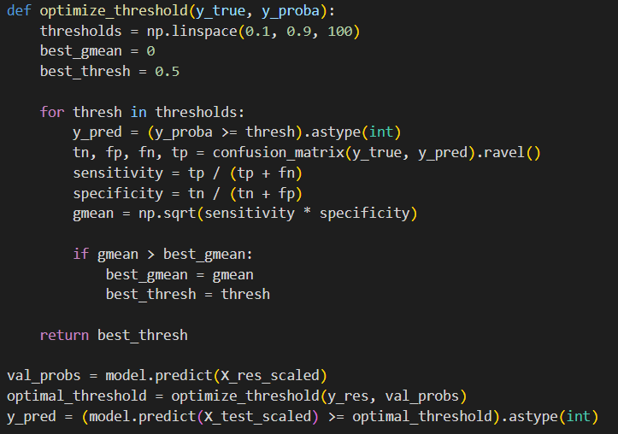
Threshold Optimization
A custom function was implemented to determine the optimal decision threshold.
Thresholds from 0.1 to 0.9 were tested based on maximizing the geometric mean (G-mean).
G-mean balances sensitivity (recall) and specificity, improving fairness in imbalanced datasets.
The final predictions on the test set used this optimized threshold instead of the default 0.5.

Slide 16
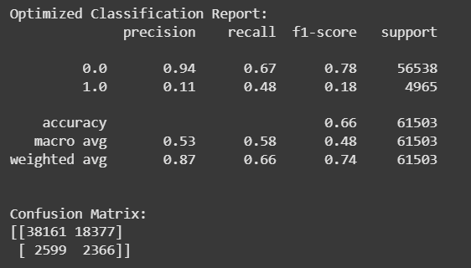
Evaluation Metrics
The optimized model achieved 48% recall and 18% F1-score on the default class (minority).
Despite a low precision of 0.11 for defaults, the recall nearly doubled after optimization.
Macro average F1-score was 0.48, while the overall accuracy was 66%, which is misleading due to imbalance.
Weighted average scores better represent performance across both classes

Slide 17
Key Takeaways
Hybrid Resampling and Focal Loss: The combination significantly improves recall for the rare default class.
Feature Engineering: Crucial for extracting meaningful patterns and improving model performance.
Neural Networks: When properly tuned, they can effectively handle tabular data and outperform traditional machine learning models in predicting loan defaults.

Slide 18


